Slide 1
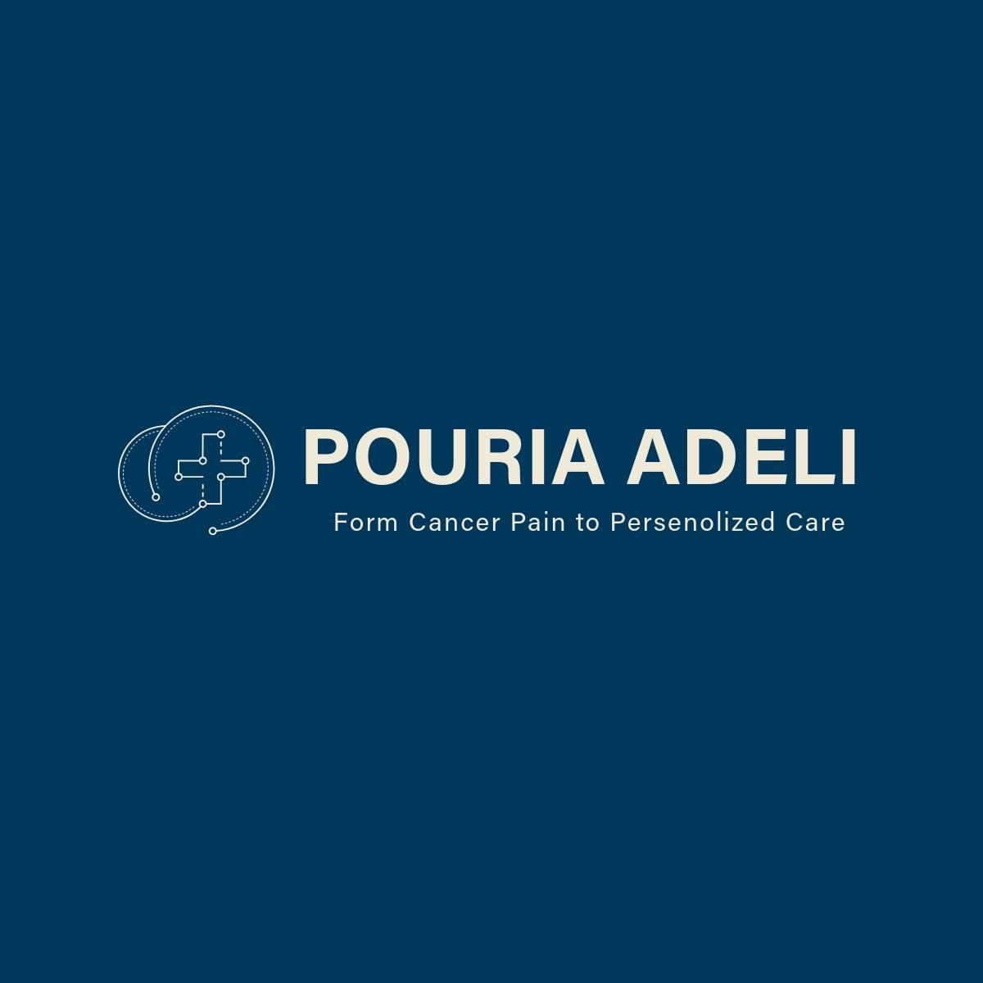
Future of Radiation Oncology
Dr. Pouria adeli

Slide 2
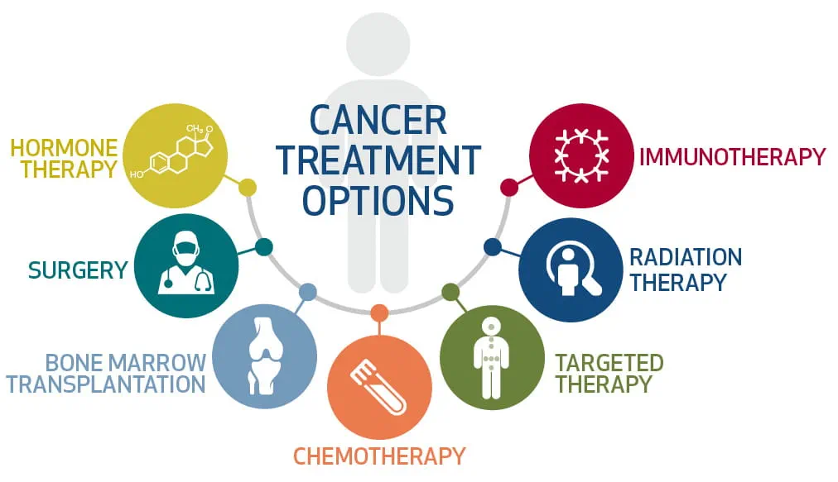
Treatment Pathway

Slide 3
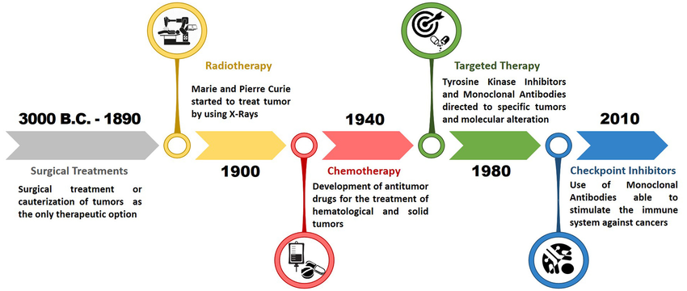
History

Slide 4
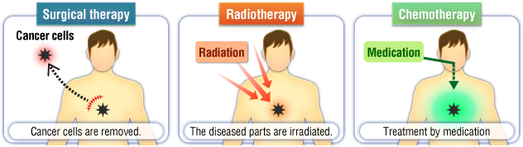
Treatment Pathway

Slide 5
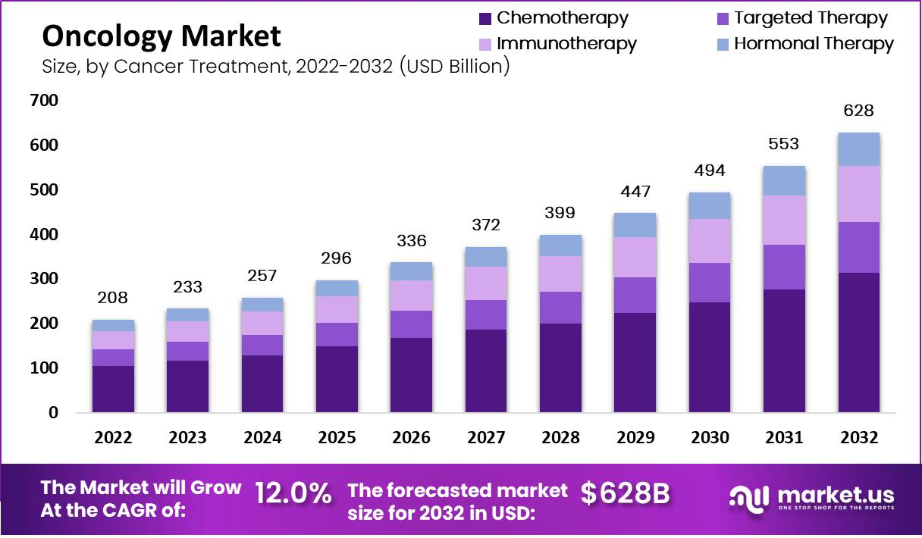
Oncology Market

Slide 6
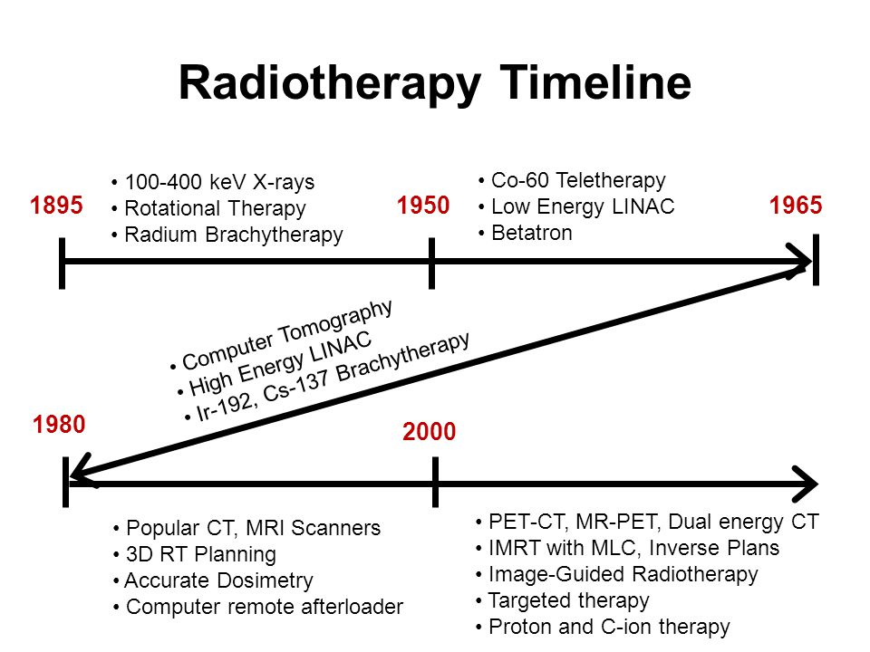
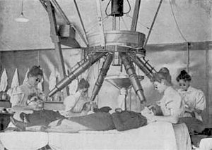
History of Radiotherapy

Slide 7
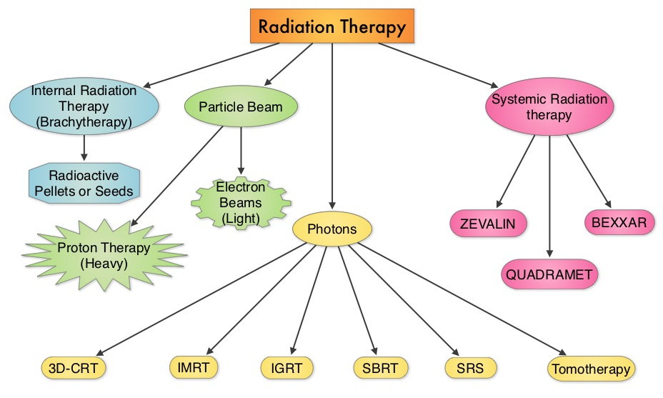
Radiotherapy

Slide 8
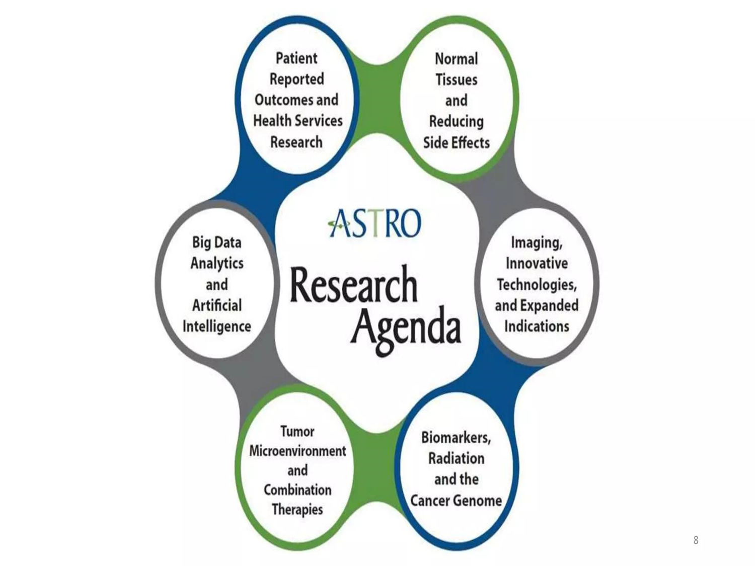
Research

Slide 9
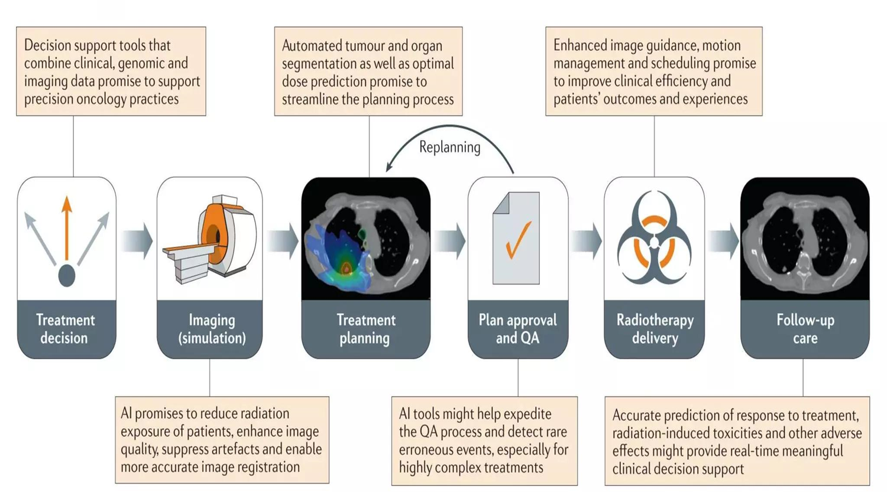
AI in radiation therapy

Slide 10
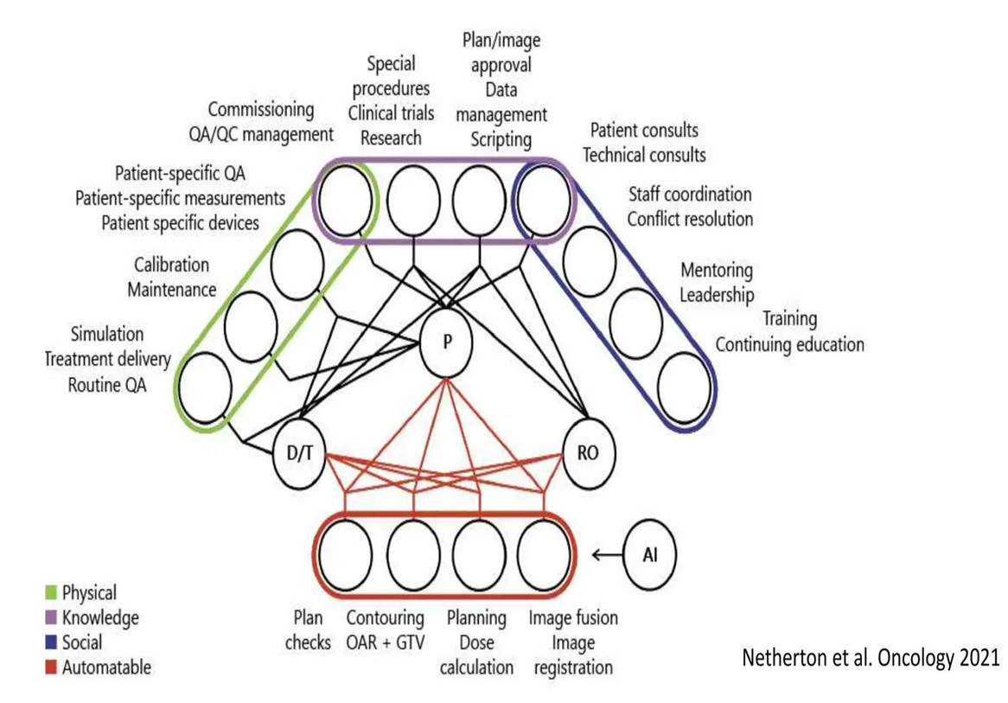
AI and Modern Clinic

Slide 11
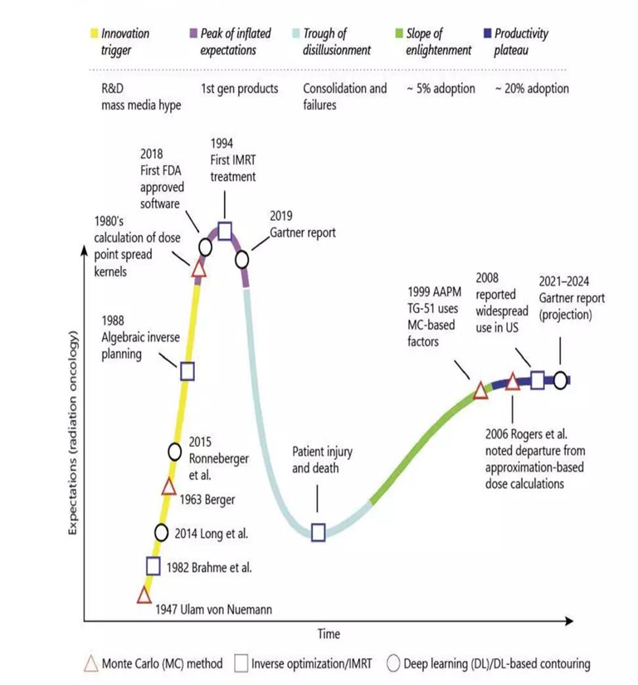
Three Major Innovation in Radiation oncology

Slide 12
Treatment planning is not an efficient process
Inputs are not always uniform
  Lack of good radiotherapy protocols
  Lack of information at the start of the treatment planning process
  Competing goals of radiotherapy are not always defined at the beginning of the radiotherapy planning process

Slide 13
Two principle areas of AI use in radiotherapy planning
  Knowledge based planning
  Multi parameter optimisation

Slide 14
Two principle areas of AI use in radiotherapy planning
  Knowledge based planning
  Multi parameter optimisation

Slide 15
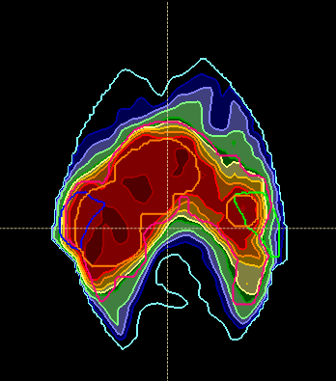
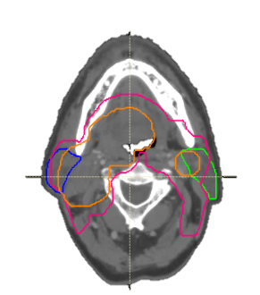
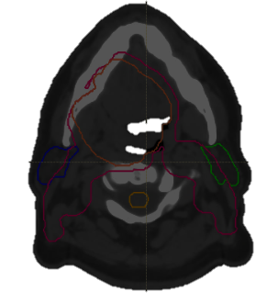
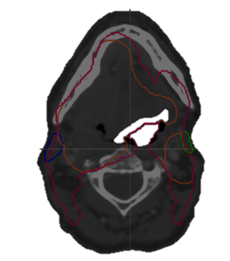
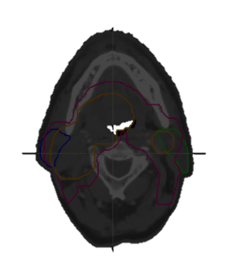
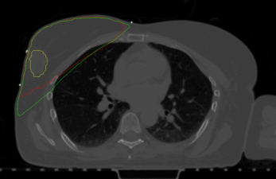
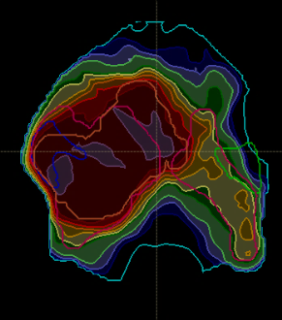
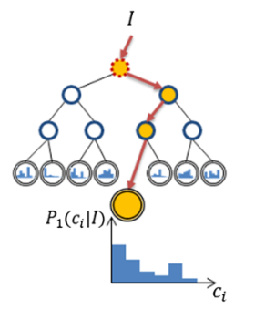
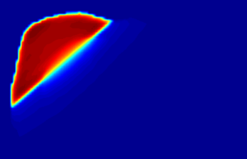
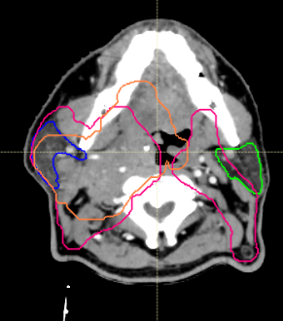
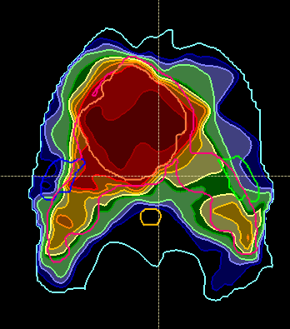
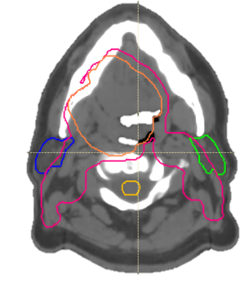



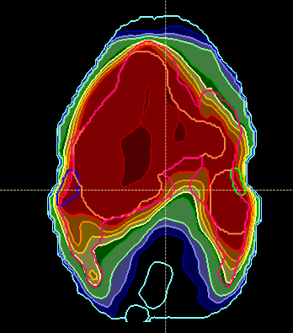
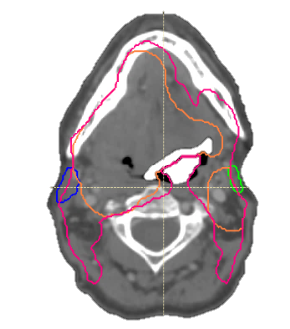
Dose Inference
Atlas Regression Forests are
inversely weighted by predicted atlas accuracy
Courtesy Tom Purdie
Notes:
Closest patients on the manifold have the greatest impact on the dose distribution
PT2 is the predicted dose. PT3 in the middle. PT1 at top. PT4 at bottom

Slide 16
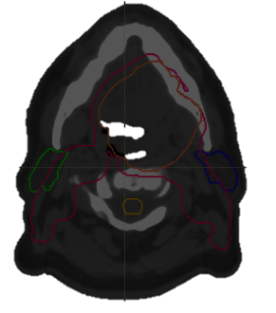
Atlas-Selection Learning
Density estimates over observed features are computed
Additional Regression Forests learn distances:
    P(accuracy | Atlas, Novel Image)
Courtesy Tom Purdie
Notes:
Density estimate over observed features computed
i.e. P( features | image)
Some features will not be relevant to dose
E.g. opposite side breast shape, arm shape/size

Slide 17
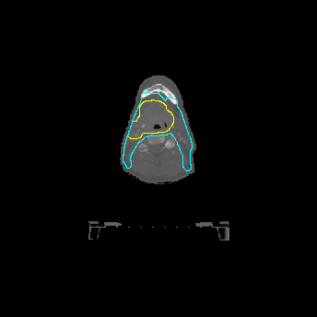
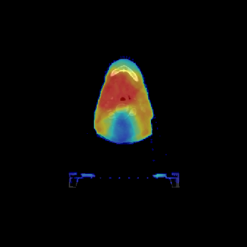
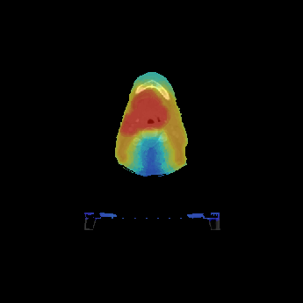
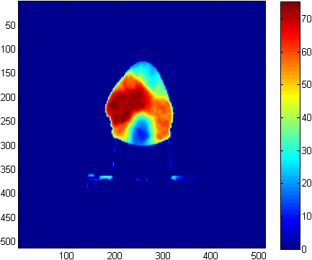
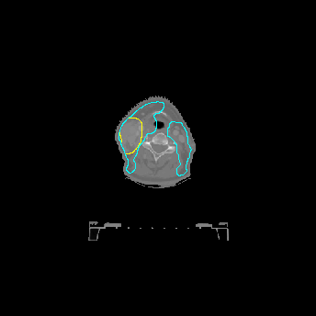
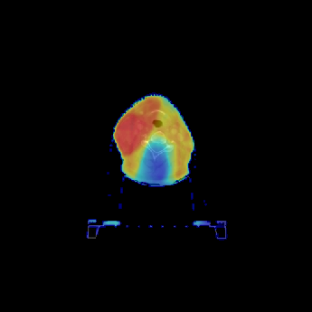
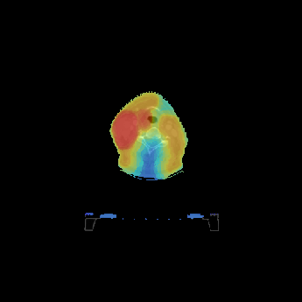
Example Planning Results
PTV Contours
Clinical Dose
Predicted Dose
Patient 1
73 Gy
Patient 2
Courtesy Tom Purdie

Slide 18
Two principle areas of AI use in radiotherapy planning
  Knowledge based planning
  Multi parameter optimisation

Slide 19
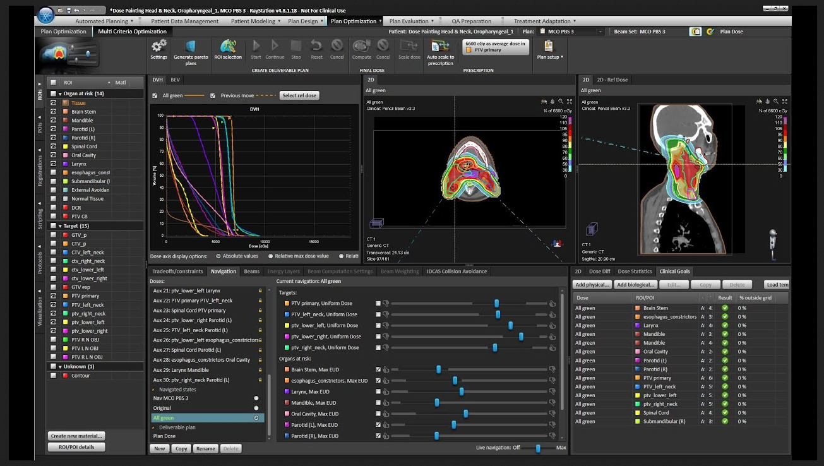
Multi parameter optimisation

Slide 20
Multi parameter optimization

Slide 21
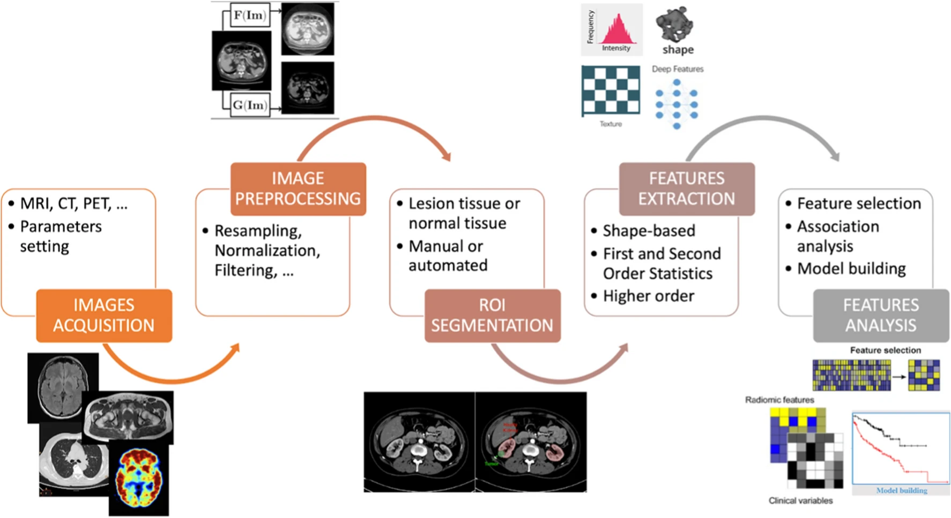
Radiomics

Slide 22
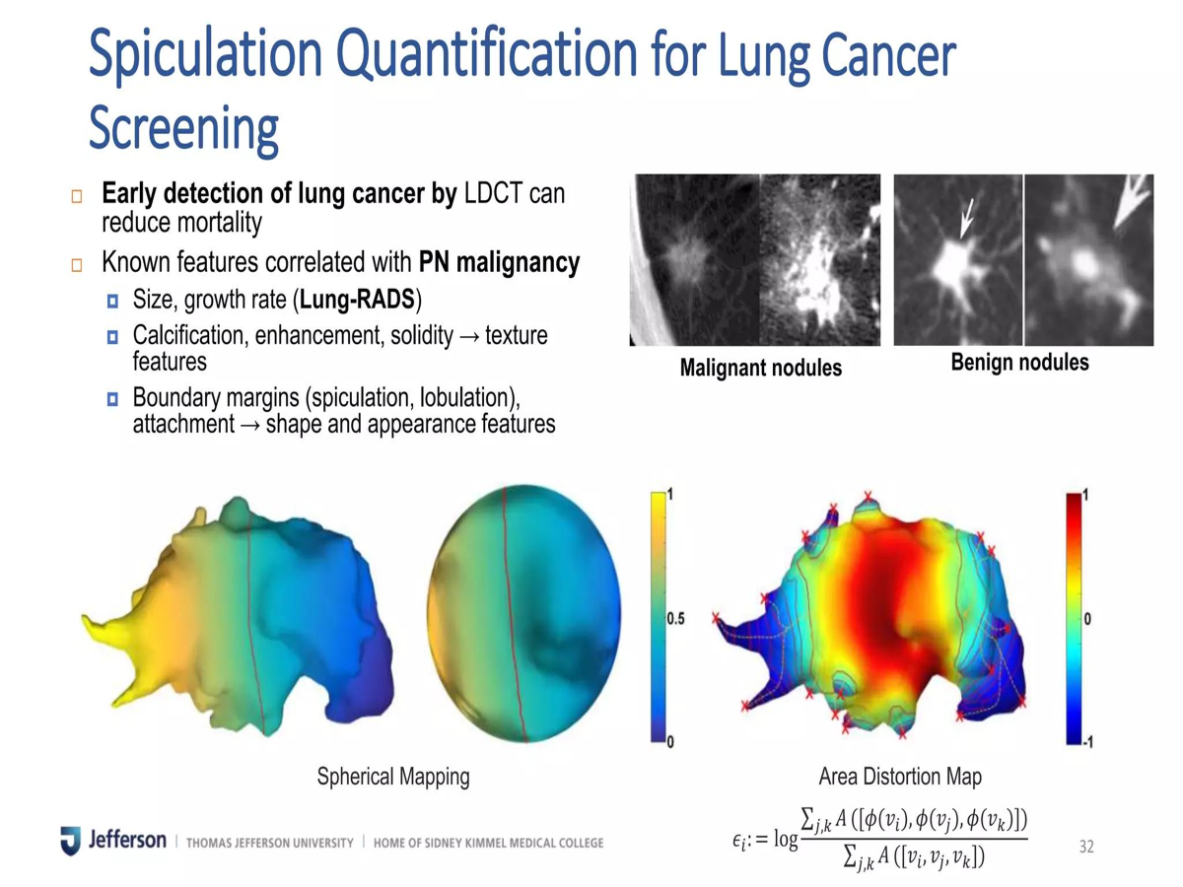
Radiomics

Slide 23
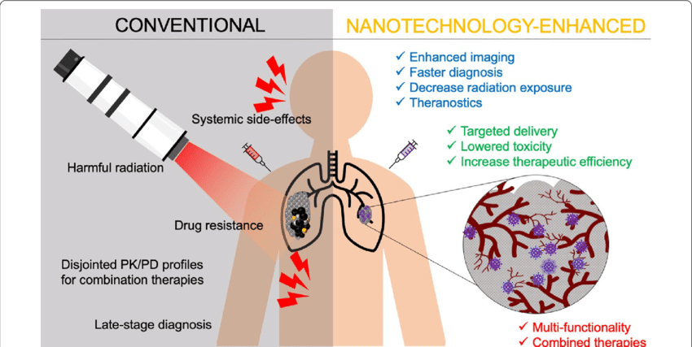
Nanotechnology

Slide 24
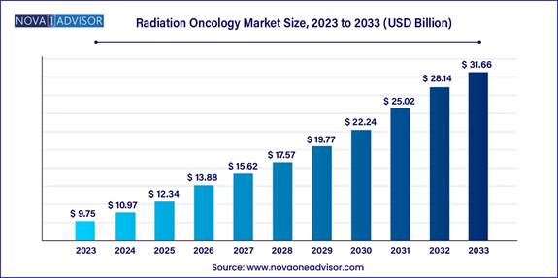
Market

Slide 25
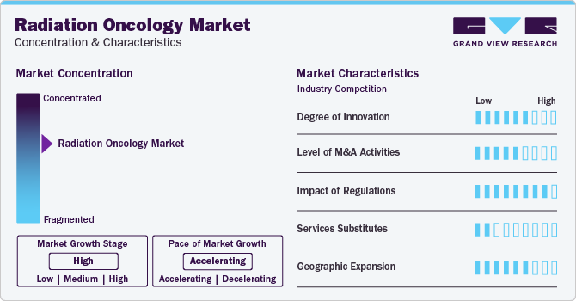
Market

Slide 26
Key Highlights of Radiation Oncology :
IMRT Segment: The IMRT (Intensity-Modulated Radiation Therapy) segment accounted for the largest share of the radiation oncology market in 2023, driven by high demand and increased availability of technologically advanced IMRT in countries with unmet treatment needs.
Brachytherapy Growth: Brachytherapy is estimated to be the fastest-growing segment in the forecast period due to its high adoption rate and minimal risk of side effects.
3D-CRT Overview:
  3D-CRT (Three-Dimensional Conformal Radiation Therapy) helps project radiation beams that match the tumor’s shape, which minimizes damage to healthy tissue.
  It allows for higher dose delivery to the tumor site, enhancing its effectiveness in shrinking and destroying the tumor.
  3D-CRT is primarily used for treating head & neck, liver, prostate, lung, and brain cancers.
Advancements in Brachytherapy:
  Brachytherapy offers precise, targeted dose delivery and personalized treatment options, particularly for prostate cancer.
  Compared to conventional treatments, brachytherapy's improved efficacy and reduced setup time are driving its global growth.
  Supportive reimbursement policies for brachytherapy products have also reduced treatment costs, encouraging more patients to opt for this therapy.
  In May 2020, Isoray received approval for billing codes to reimburse Cesium-131 for use in hospitals, which is employed in brachytherapy to treat various organ tumors.

Slide 27
Key Development:
In October 2023, Accuray incorporated achieved a significant milestone as their Tomo C radiation therapy system gained approval from the Chinese National Medical Products Administration (NMPA). This strategic move by the company reflects its commitment to expanding market presence and catering to the growing demand for advanced radiation oncology solutions in China.
In July 2023, in India IBA took a step towards collaboration by forming a partnership with Apollo Proton Cancer Centre (APCC). The purpose was to offer training sessions for oncologists, focusing on proton beam therapy, demonstrating a commitment to knowledge sharing and professional development within the radiation oncology sector.
In June 2023, PharmaLogic Holdings Corp., a key player in the radiation oncology market, took a significant step by signing a Master Services Agreement. This agreement focuses on the development and production of theranostic candidates VMT-01 and VMT-NET, aiming to address metastatic melanoma and neuroendocrine cancers. Currently, these radiopharmaceuticals are undergoing research and development, highlighting the company's strategic commitment to advancing diagnostic and treatment solutions in the field.

Slide 28
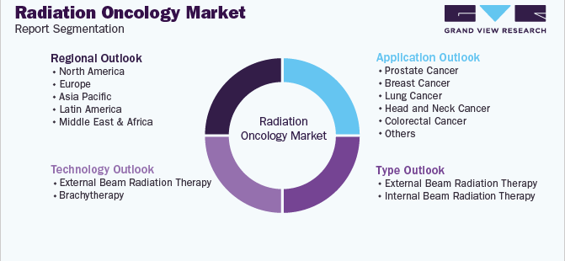
Key Segment:

Slide 29
Nuclear medicine and Cancer
Diagnosis
Treatment

Slide 30
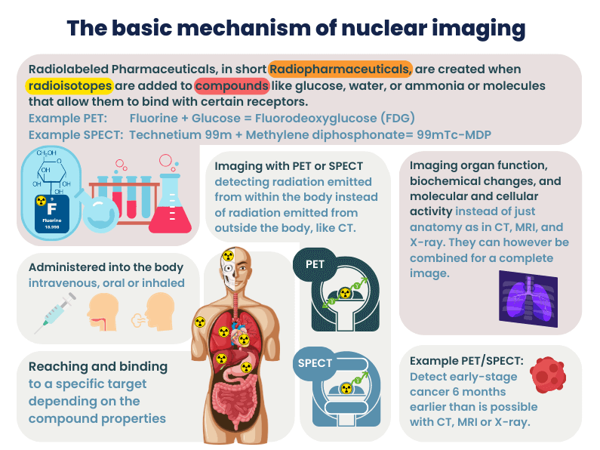

Slide 31
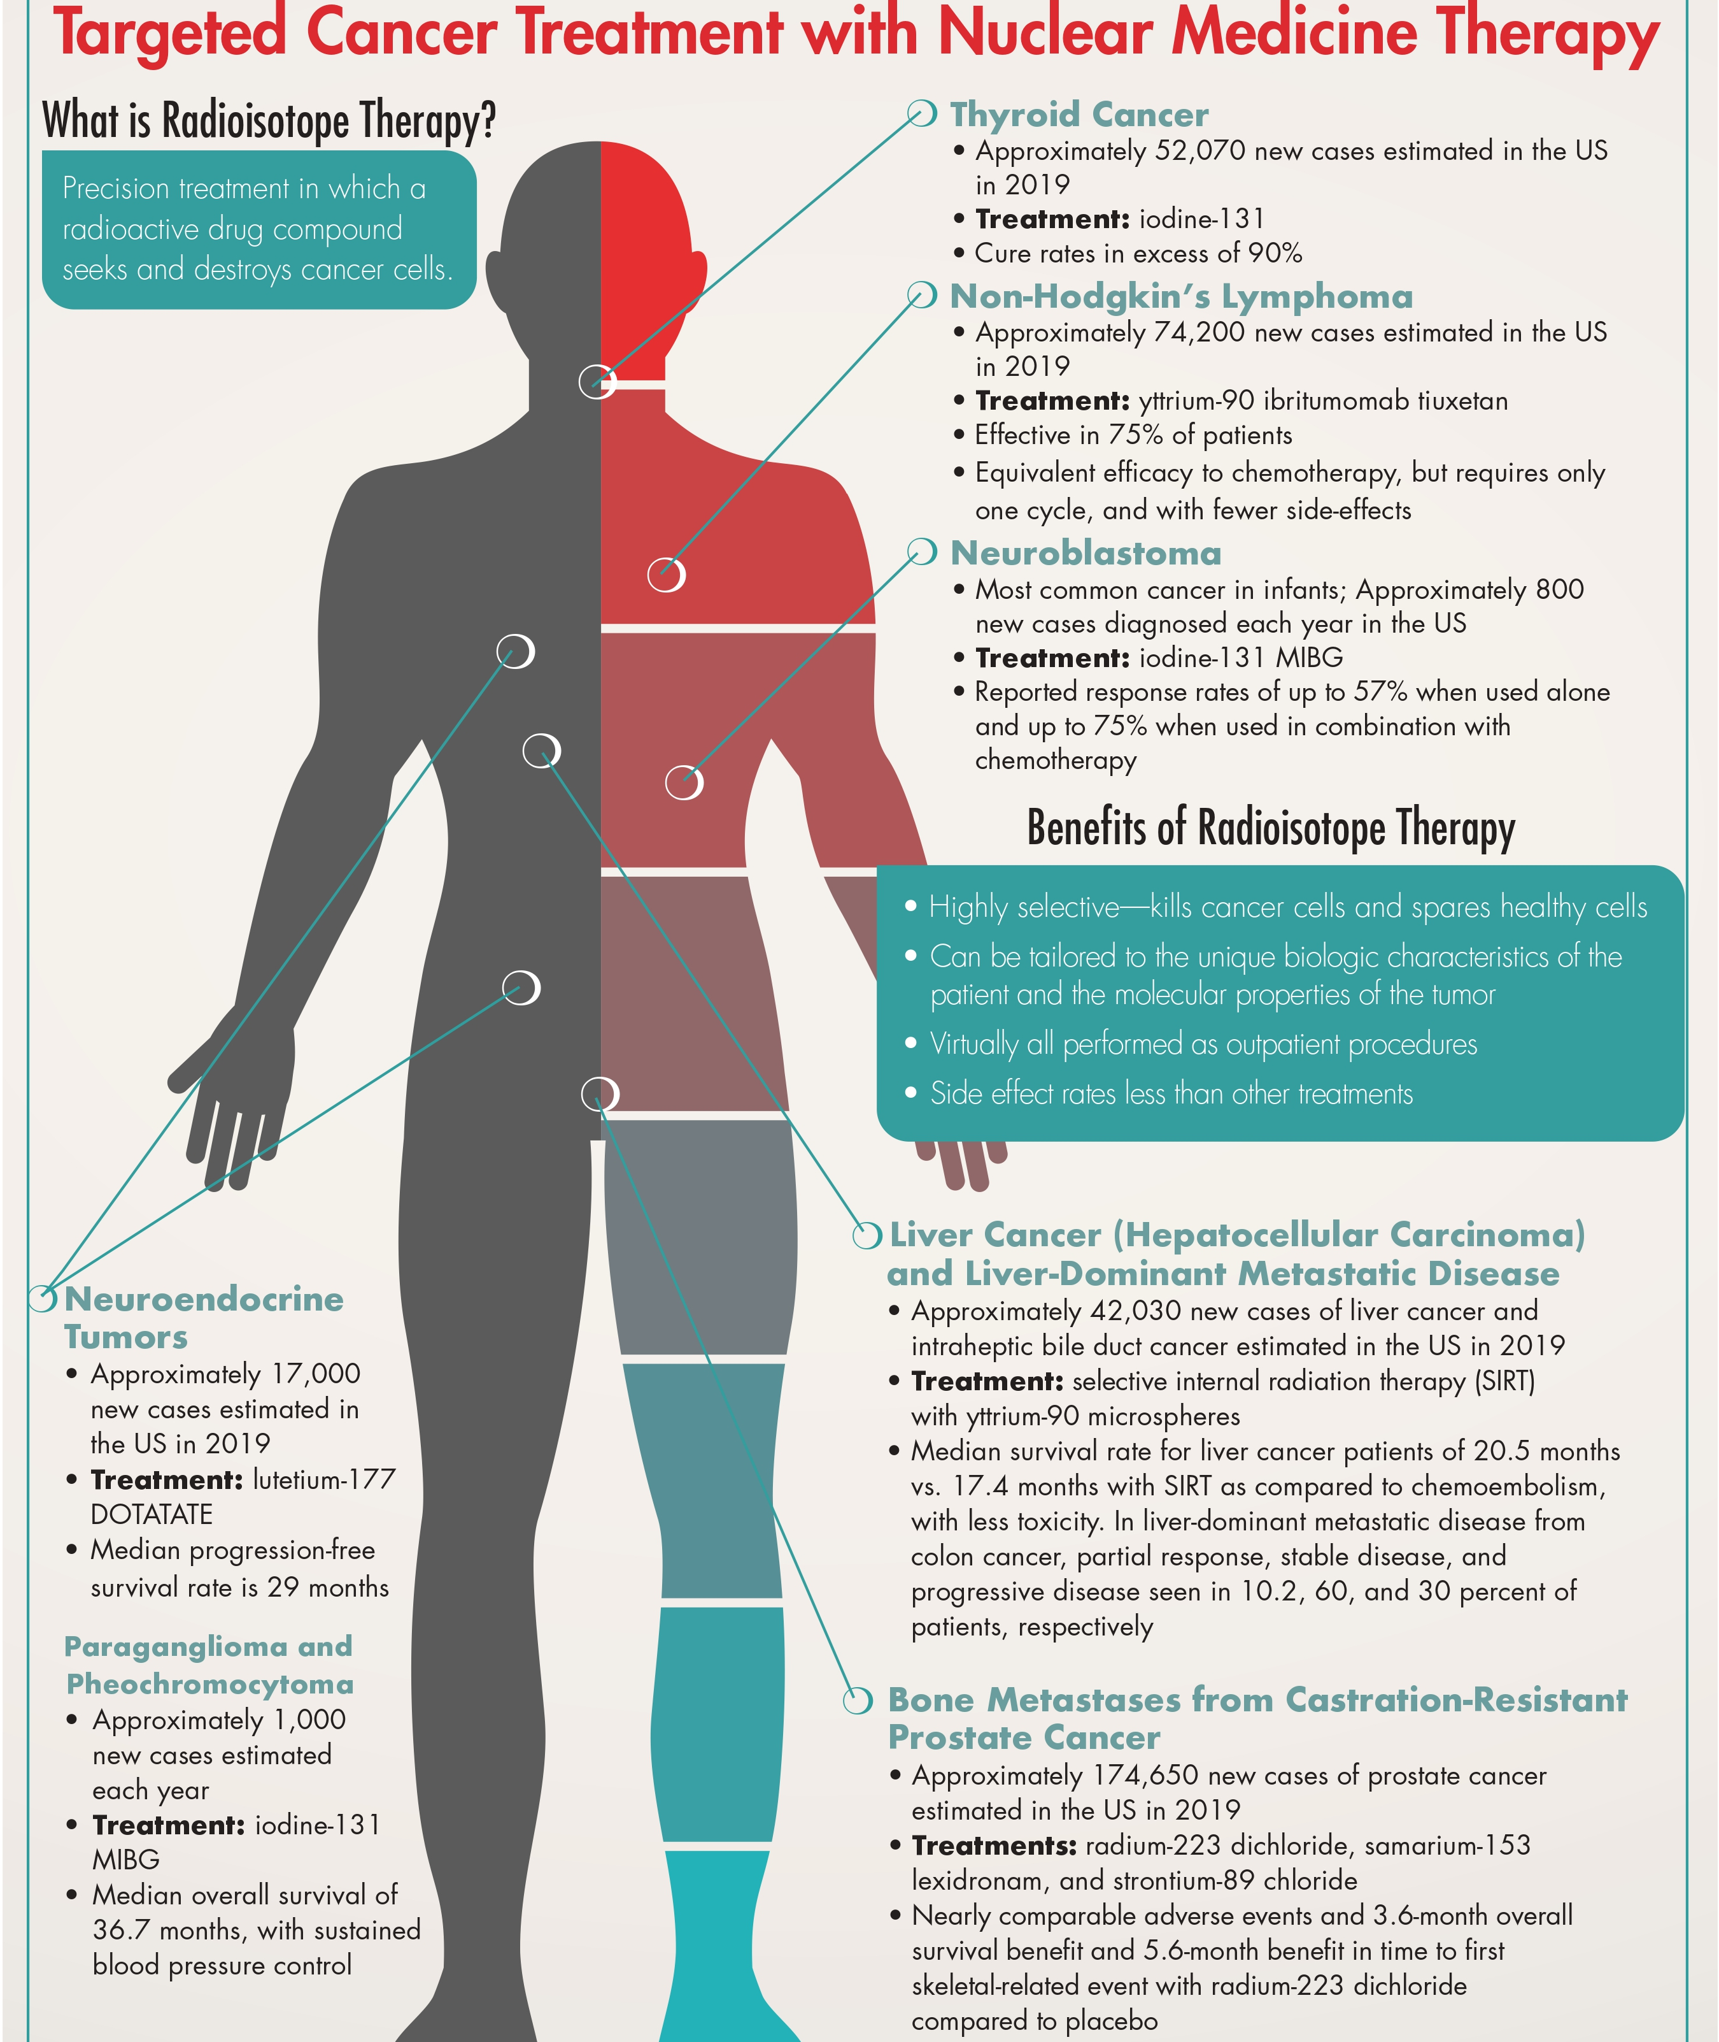

Slide 32
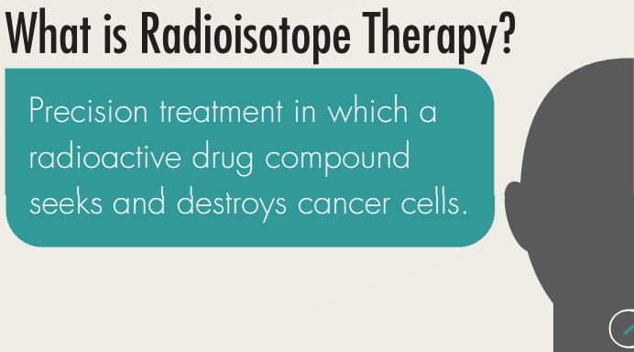

Slide 33
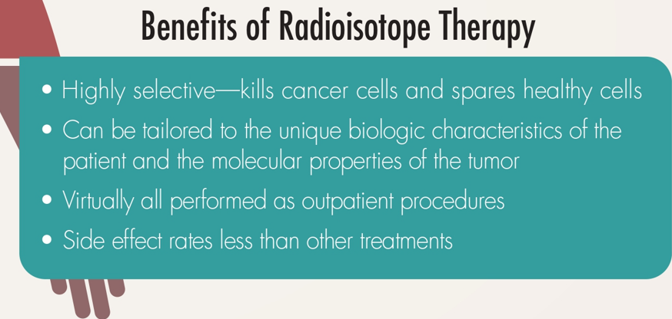

Slide 34
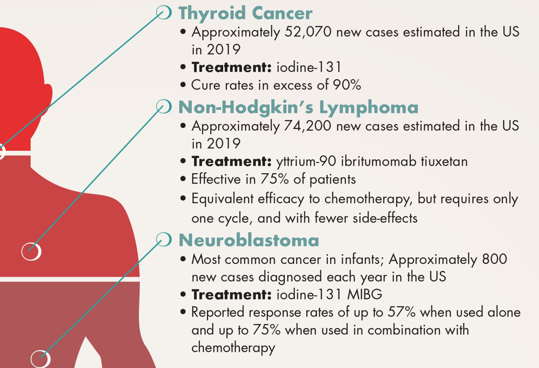

Slide 35
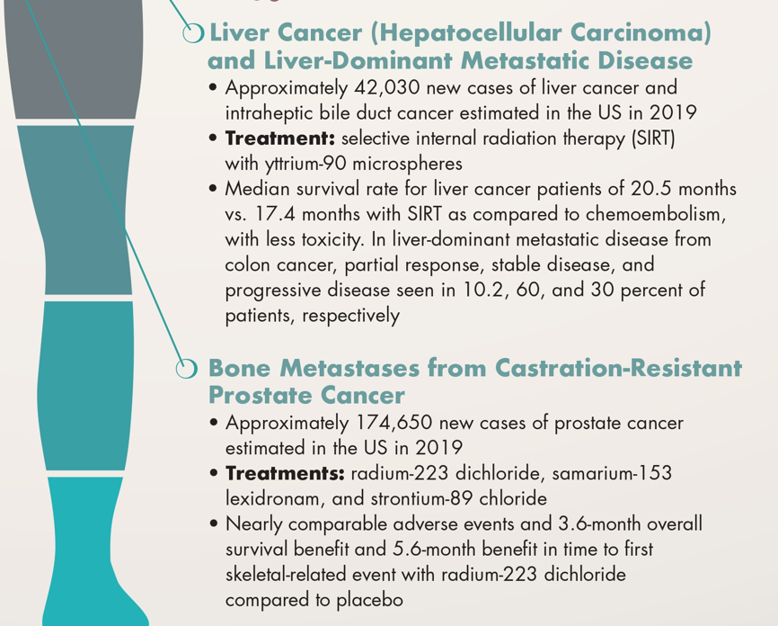

Slide 36
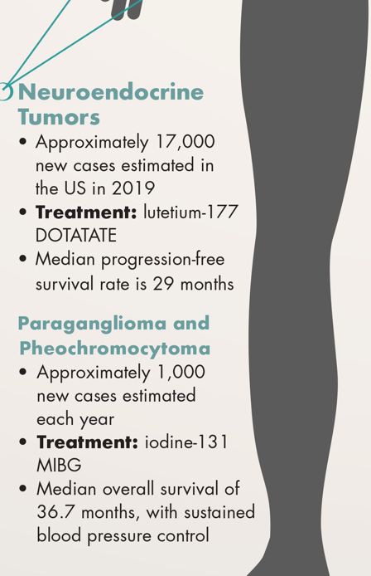

Slide 37
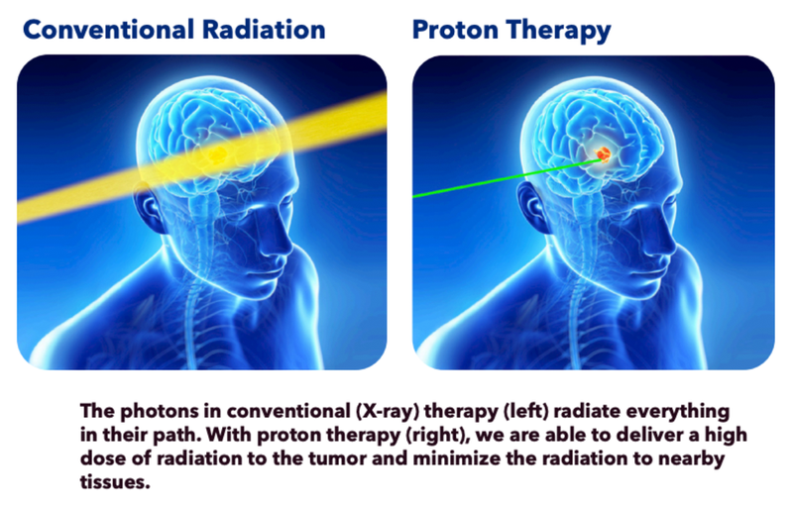
Proton Beam

Slide 38
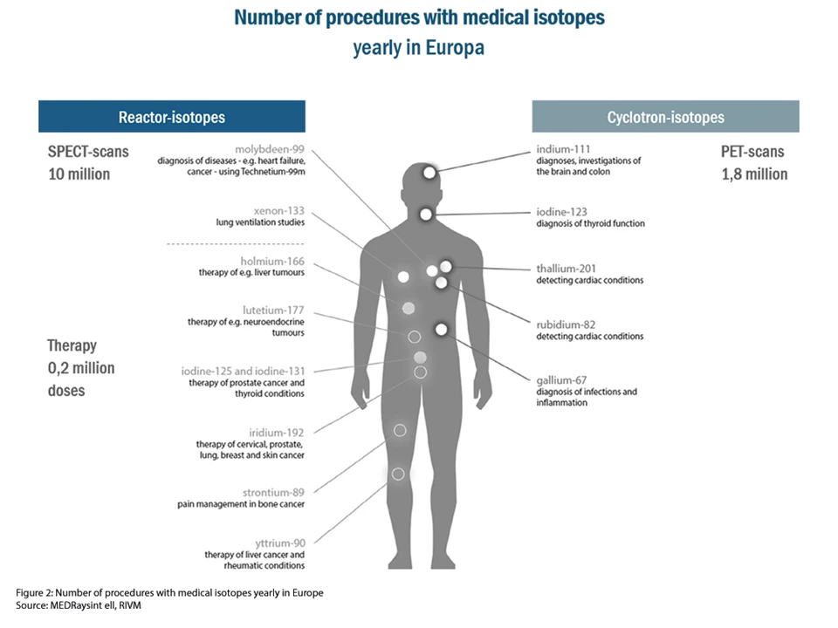

Slide 39


Slide 40


Slide 41
Key Highlights of the Global Nuclear Medicine Market:
Market Size: The global nuclear medicine market is projected to reach approximately USD 25.0 billion by 2032, with a CAGR of 13.80%.
Revenue Distribution: Therapeutic radiopharmaceuticals account for 55.4% of the market's revenue share.
Leading Segments:
The oncology sector holds the largest share, accounting for 34% of market revenue.
North America dominated the market with a 47.2% share in 2022.
The APAC region is expected to be the fastest-growing segment.

Slide 42
Key Highlights of the Global Nuclear Medicine Market:
Growth Drivers:
  Government initiatives to expand access to nuclear medicine.
  A robust pipeline of new products.
  Favorable reimbursement conditions in the U.S., particularly for radiopharmaceuticals.
  Advances in nuclear imaging technologies, including PET/PET-CT and SPECT-CT systems.
  New launches of therapeutic and diagnostic radiopharmaceuticals.
Future Outlook: Diagnostic radiopharmaceuticals are anticipated to dominate due to the increasing demand for early detection.
End-Users: Hospitals and clinics are the primary end-users, with diagnostic centers showing significant growth potential.
Regional Cost Insight: The cost of nuclear medicine treatments in India ranges from approximately USD 3,312 to USD 23,850.

Slide 43
Key Highlights of the Global Nuclear Medicine Market:
GE HealthCare (U.S.)
Lantheus Holdings, Inc. (U.S.)
Nordion (Canada) Inc.
Bracco (Italy)
Curium (France)
Bayer AG (Germany)
Siemens Healthineers AG (Germany)
Novartis AG (Switzerland)
Cardinal Health (U.S.)
Norgine (Netherlands)
DuchemBio, Co., Ltd. (South Korea)

Slide 44
Thank You

